Slide 1
Modernize in the Cloud with Azure SQL Database Managed Instance

Slide 2
Technology is shaping how businesses innovate and grow
Engage your customers
Transform your products
Digital transformation
Empower your employees
Optimize your operations
Notes:
Technology is omnipresent. It’s shaping how businesses plan for innovation and growth within their markets. The importance of digital transformation is urgent; Since 2000, 52% of Fortune 500 companies are gone due to digital disruption.
We see companies responding by creating digital strategies across four core areas: engaging their customers, empowering their employees, optimizing their operations, and transforming their products.

Slide 3
Getting ahead means getting to the cloud
Companies that embrace the cloud grow 19.6% faster
More than 80% of organizations now adopt cloud-first strategies
Notes:
Getting ahead means embracing digital transformation and getting to the cloud.
Studies show that companies that embrace the cloud grow 19.6% faster than those who do not.¹ More than 80% of organizations now adopt cloud-first strategies as part of an overall digital transformation.²
As a first step on that transformation, IT must optimize its operations to effectively manage growth in the cloud.
Sources:
1. IDC Digital Universe Executive Summary: https://www.emc.com/leadership/digital-universe/2014iview/executive-summary.htm
2. Building Trust in a Cloudy Sky
https://www.mcafee.com/us/resources/reports/rp-building-trust-cloudy-sky.pdf

Slide 4
IT optimization is key to digital transformation
Priorities
Eliminate time spent managing “long tail” of applications—lift and shift to managed cloud
Free up limited IT resources to drive transformation
Migrate business critical apps to cloud—extend and innovate
SQL Server
37% of all units run Microsoft, >50% of units run 2008/R2 or older²
¹ Pie Chart *IDC Worldwide DB Forecast Dec 2016
² Microsoft Internal Sources
Notes:
To stay competitive and get ahead in today’s marketplace, IT organizations are continuously looking at ways to optimize how they maintain and use the data that fuels their operations. Modernizing in the cloud as part of a digital transformation can deliver the right mix of operational efficiencies and business enablement to drive continued growth.
[click]
IT optimization is key to driving an organization’s digital transformation, and it introduces some new priorities for IT to consider:
Eliminate time spent managing “long tail” of applications—lift and shift to managed cloud
Free up limited IT resources to drive transformation
Migrate business critical apps to cloud—extend and innovate
The opportunity is significant. In a December 2016 study, IDC estimated that 37% of the global database installed base runs on Microsoft SQL Server, with over 50% running on 2008/R2 or older.

Slide 5
Azure SQL Database
The best and most economical cloud destination for your SQL Server apps
Built-in intelligence
Breakthrough productivity and performance
Seamless and compatible
Competitive TCO
Realize up to a 406% ROI over on-premises and hosted solutions
Notes:
Azure SQL Database is a fully-managed relational database-as-a service that provides the best and most economical cloud destination for your SQL Server data. SQL Database uses the Microsoft SQL Server Engine, which means it’s high-performance, reliable, and secure. You can use it to build data-driven applications and websites in the programming language of your choice, without needing to manage infrastructure.
As a fully-managed service, Microsoft operates SQL Server for you and ensures availability and performance. Features that come with SQL Database include, but are not limited to: provisioning and resizing (w/ Azure Portal experience), built-in auto HA (99.99%), automatic backup, point-in-time-restore (database-level), and active geo-replication. Because Microsoft assumes much of the daily maintenance, administration and infrastructure costs, your IT organization can quickly realize cost and operational benefits that you may not have otherwise experienced with your on-premises or hosted solution. In fact, a study by IDC found that organizations who modernized their databases from SQL Server to SQL Database realized up to a 406% ROI over five years.¹
In addition to the benefits of a fully-managed service, SQL Database also provides key benefits in some specific areas:
It has built-in intelligence that helps you dramatically reduce the costs of running and managing databases and maximizes both the performance and security of your application.
SQL Database provides breakthrough productivity and performance to meet the demands of today’s apps. Each database is isolated from each other and portable, each with its own service tier with a guaranteed performance level. SQL Database provides different performance levels for different needs, and enables databases to be pooled to maximize the use of resources and save money. You can adjust performance with minimal downtime to your app. Dynamic scalability enables your database to transparently respond to rapidly changing resource requirements and enables you to only pay for the resources that you need when you need them. In-memory technologies provide real-time business insight with up to 30x improved throughput and latency and up to 100x faster queries and reports.
It will provide the ability to seamlessly lift and shift your SQL Server data to the cloud to a managed instance with a full SQL Server programming surface area that removes the need to re-architect your apps, saving you time and resources.
SQL Database combines the operational and financial benefits of a managed service with a financially-backed SLA and business continuity tools to protect the lifeblood of your business, your data. SQL Database also offers a Azure Hybrid Benefit for SQL Server that maximizes the investments you’ve made in on-premises licensing by providing discounted rates in the cloud. The new vCore-based purchasing model is designed to give customers flexibility, control, transparency and a straightforward way to translate on-premises workload requirements to the cloud. It also allows customers to scale compute and storage based upon their workload needs. We’ll talk more about that more momentarily.
¹The Business Value of Microsoft Azure SQL Database Services, IDC, March 2015

Slide 6



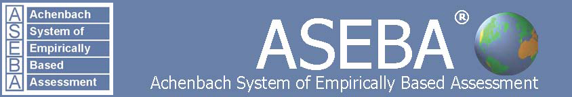
Azure SQL Database Momentum
4.1million
databases
154PB total size
421K subscriptions
3Trillion batch requests/day
1.4 million HTAP transactions/sec
100million queries analyzed/hour
“We had an incident lasting for about 6 months. Before Intelligent insights we have not had a way of figuring out where do we even start troubleshooting. Intelligent Insights gave us a list of things to do. What Intelligent Insight does is that it enables us to pinpoint where the problem is and to get a fix deployed within 24hrs.”
Frans Lytzen – CTO, New Orbit
““Intelligent Insights proactively finds a database performance problem in a more efficient way and much faster than humans. With it we can proactively help customers until we have a fix for the problem.”, Bauke Stil, Application Manager, SnelStart
Bauke Stil, App Manager, SnelStart
“SQL Threat Detection helps us to be ahead of the threats instead of chasing them.”
Shahin Kohan, CTO
“SQL Threat Detection helps us respond to activities, which were not visible beforehand.”
Manrique Logan, architect & technical lead

Slide 7
Introducing Azure SQL Database Managed Instance
Azure SQL Database
Managed
Instance
Single
Elastic Pool
SQL
SQL
Instance-scoped programming model with high compatibility to SQL Server
Standalone managed database for predictable and stable workloads
Shared resource model for greater efficiency through multi-tenancy
Best for modernization at scale with low cost and effort
Notes:
Introducing Azure SQL Database Managed Instance
SQL Database Managed Instance is an expansion of the existing SQL Database service designed to enable database migration to a fully-managed database service, without re-designing the application.
It’s important to note that Managed Instance isn’t a new service – it is a third deployment option within Azure SQL Database, sitting alongside single databases and elastic pools. As part of Azure SQL Database, Microsoft’s fully managed cloud database service, it inherits all its built-in features.
A SQL Database Managed Instance offers a simplified instance-scoped programming model that is like an on-premises SQL Server instance. The databases in a SQL Database Managed Instance share the resources allocated to the Managed Instance, and the Managed Instance also represents the management grouping for these databases. The emphasis of this offering is on high compatibility with the programming model of an on-premises SQL Server and out-of-box support for a large majority of SQL Server features and accompanying tools/services.
Each standalone database is assigned a certain amount of resources via performance tiers: Basic, Standard, and Premium. The emphasis of this offering focuses on a simplified database-scoped programming model and applications with a predictable pattern and relatively stable workload.
An elastic database pool is a shared resource model that enables higher resource utilization efficiency, and all the databases within an elastic pool share predefined resources within the same pool. The emphasis of this offering is on a simplified database-scoped programming model for multi-tenant SaaS apps. The workload pattern is well-defined and is highly cost-effective in multi-tenant scenarios. For ISVs with SaaS apps, the savings can be significant, in the hundreds of thousands of dollars or more.

Slide 8
Built-in intelligence to protect and optimize
Tuning algorithms
Built-in intelligence learns unique database patterns and automatically tunes for improved performance
Intelligent Threat Detection monitors, detects, and alerts on malicious activities
Vulnerability Assessment discovers, tracks and remediates potential database vulnerabilities
SQL
SQL Database
Database advisor
“My app gets auto-tuned”
“I can do more in less time”
Developer no admin skills
DBA of many databases
Notes:
The significant growth in data challenges IT organizations to strike a balance between the daily management and security of their data and the resources necessary to maintain it. IT organizations are faced with new demands on app performance, let alone remaining vigilant in the face of ongoing cybersecurity threats. Sometimes it can be a challenge to simply keep up with the limited resources on-hand.
With SQL Database, you get built-in intelligence that helps you dramatically reduce the costs of running and managing databases and maximizes both the performance and security of your application. Running millions of customer workloads around-the-clock, SQL Database collects and processes a massive amount of telemetry data, while also fully respecting customer privacy behind the scenes. Various algorithms are continuously evaluating the telemetry data so that the service can learn and adapt with your application. Based on this analysis, the service comes up with performance improving recommendations through Database Advisor, tailored to your specific workload.
Intelligent Threat Detection leverages SQL Database auditing to continuously monitor Azure SQL databases for potentially harmful attempts to access sensitive data. SQL Database Threat Detection provides a new layer of security, which enables customers to detect and respond to potential threats as they occur by providing security alerts on anomalous activities. Users receive alerts upon suspicious database activities, potential vulnerabilities, and SQL injection attacks, and anomalous database access patterns. SQL threat detection alerts provide details of suspicious activity and recommend action on how to investigate and mitigate the threat. Users can explore the suspicious events to determine if the event results from an attempt to access, breach, or exploit data in the database. Threat detection makes it simple to address potential threats to the database without the need to be a security expert or manage advanced security monitoring systems.
Vulnerability Assessment for Azure SQL Database provides you with a one-stop-shop to discover, track, and remediate potential database vulnerabilities. It gives visibility into your security state, and includes actionable steps to investigate, manage, and resolve security issues and enhance your database fortifications. The feature is now also part of a new security package for your Azure SQL Database, known as SQL Advanced Threat Protection, that provides a single go-to location for advanced SQL security capabilities, including Threat Detection, Vulnerability Assessment, and Information Protection.

Slide 9
Breakthrough productivity and performance
30x faster transactions with in-memory OLTP
Realize the benefits of real-time operational analytics
Enable scale-up with near zero downtime through cloud-born innovation
100x performance gains with in-memory analytics
near 100%
uptime with dynamic scalability
Notes:
Experience up to 30x improved throughput and latency and up to 100x faster queries and reports with in-memory technologies.¹ In-memory OLTP can dramatically improve throughput and latency on transactional processing workloads and can provide significant performance improvements.
Dynamic scalability enables your database to transparently respond to rapidly changing resource requirements across all service tiers: Basic, Standard, Premium (Single databases and elastic pools); General Purpose and Business Critical (Managed Instance). Scale your app from a handful of databases to thousands and manage unpredictable demand patterns, within a budget and resources you control with elastic pools.
¹ “SQL Server In-Memory OLTP and Columnstore Feature Comparison” white paper, March 2016.

Slide 10
Save time with familiar SQL Server tools and resources
Full compatibility with SQL Server 2005+
Eliminate app changes with full SQL Server programming surface
Use familiar SQL Server features in SQL Database Managed Instance
Native backup and restore
Cross-database queries and transactions
Broad security features including Transparent Data Encryption, SQL Audit, Always Encrypted and Dynamic Data Masking
SQL Agent, DBMail, and Alerts for workload orchestration improved awareness
Scenario enablers including Change Data Capture, Service Broker, Transactional Replication, and CLR
DMVs, XEvents, and Query Store for troubleshooting
Notes:
SQL Database Managed Instance reduces the differences between on-premise SQL Server and a fully managed database service, so that the migration becomes much easier.
SQL Database Managed Instance offers a simplified instance-scoped programming model that is like an on-premises SQL Server instance. The databases in Managed Instance share the resources allocated to the Managed Instance, and the Managed Instance also represents the management grouping for these databases. The emphasis of this offering is on high compatibility with the programming model of on-premises SQL Server and out-of-box support for the large majority of SQL Server features and accompanying tools/services.

Slide 11
Dedicated resources through customer isolation
VNET support in SQL Database Managed Instance
VNet-to-VNet
Enable full isolation from other tenants without resource sharing
Promote secure communication over private IP addresses with native VNET integration
Enable your on-premise identities on cloud instances, through integration with Azure Active Directory and AD Connect
Web app (public IP)
VNet2
SQL instance #1
SQL instance #2
Network isolation (customer VNET)
Tenant isolation (compute, storage)
SQL instance #3
VNet1
“Virtual data cluster” dedicated to customer (virtual private cluster, VNET, private IPs)
VPN/Express route gateway
On-premises
Notes:
SQL Database Managed Instance provides complete workload isolation of your workloads through native VNET support. We use virtual data clusters to describe the degree of isolation that customer workloads will experience with SQL Database Managed Instance. During service provisioning (on Azure Portal or through REST API), you can choose the virtual network (VNET) and the subnet to achieve full networking isolation for your Managed Instances. Once created, instances in the VNET can be reached using Azure networking mechanisms (VPN and Express Route gateways).
To two levels of isolation are provided:
Cluster (tenant ring) level: Managed Instances for a tenant are fully isolated from other tenants. No connectivity or resource sharing is possible between different tenants.
Networking level: joining instances to a subnet in a VNET and restricting access to private IP addresses only provides full isolation from public Internet.

Slide 12
Lift your sql server integration services (SSIS) packages to azure
Azure Data Factory
SSIS Integration Runtime
SQL
Easily execute and schedule your SQL Server Integration Services (SSIS) packages in managed execution environment for SSIS in Azure Data Factory (ADF)
Gain high availability, scalability and lower TCO by lifting your SSIS packages to Azure
Continue to build, monitor and manage packages with existing tools like SQL Server Management Studio (SSMS) & SQL Server Data Tools (SSDT)
Learn more
Data sources
SSIS ETL
SQL Database
Managed Instance
Cloud
On-premises
VNET
SQL
SSIS ETL
Data sources
SQL Server
Available Q2 CY 2018

Slide 13
Accelerating your journey to the cloud
Azure Database Migration Service
SQL
Fully managed database migration service for both operational databases and data warehouses
Enables reliable and seamless migrations to the cloud at scale and minimal downtime
Migrate SQL Server & 3rd party databases to Azure SQL Database
MySQL
SQL
SQL Server | Azure SQL Database single, elastic pools and Managed Instance
MySQL | Azure Database for MySQL
PostgreSQL | Azure Database for PostgreSQL
Oracle, … | Azure SQL Database & Managed Instance
Netezza, … | Azure SQL Data Warehouse
Notes:
As organizations look to optimize their IT infrastructure to have more time and resources to focus on business transformation, Microsoft is committed to accelerating these initiatives. The new Azure Database Migration Service (DMS) is a fully managed, first party Azure service that enables seamless and frictionless migrations from heterogeneous database sources to Azure Database platforms with minimal downtime. This service will streamline the tasks required to move existing competitive and SQL Server databases to Azure.

Slide 14
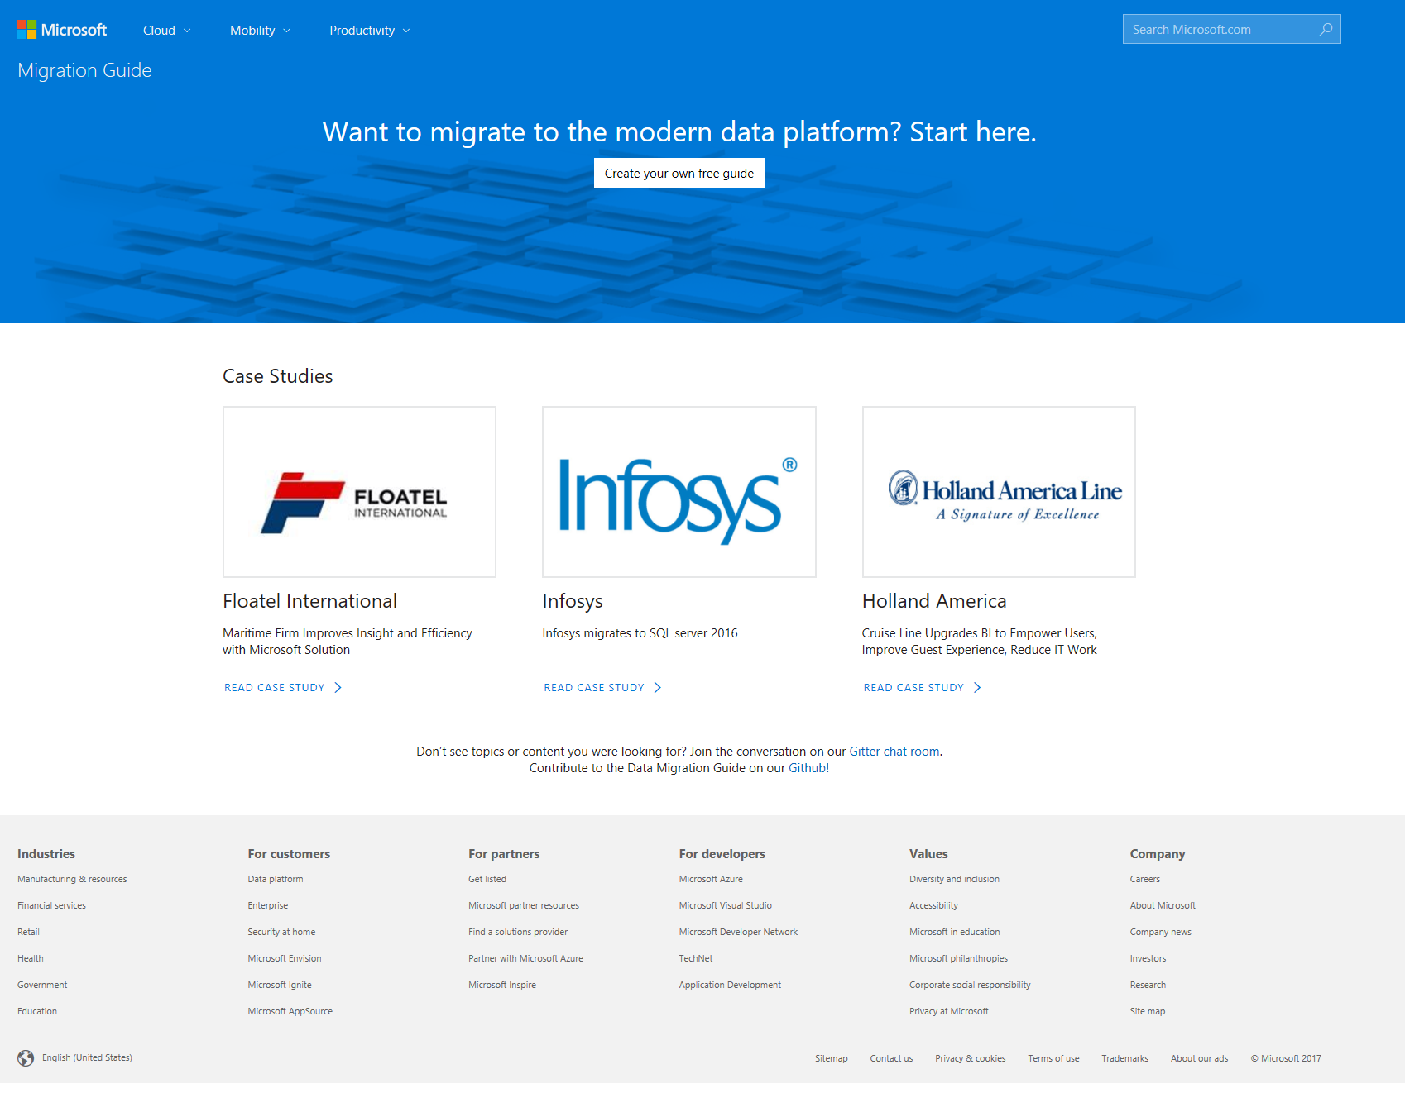
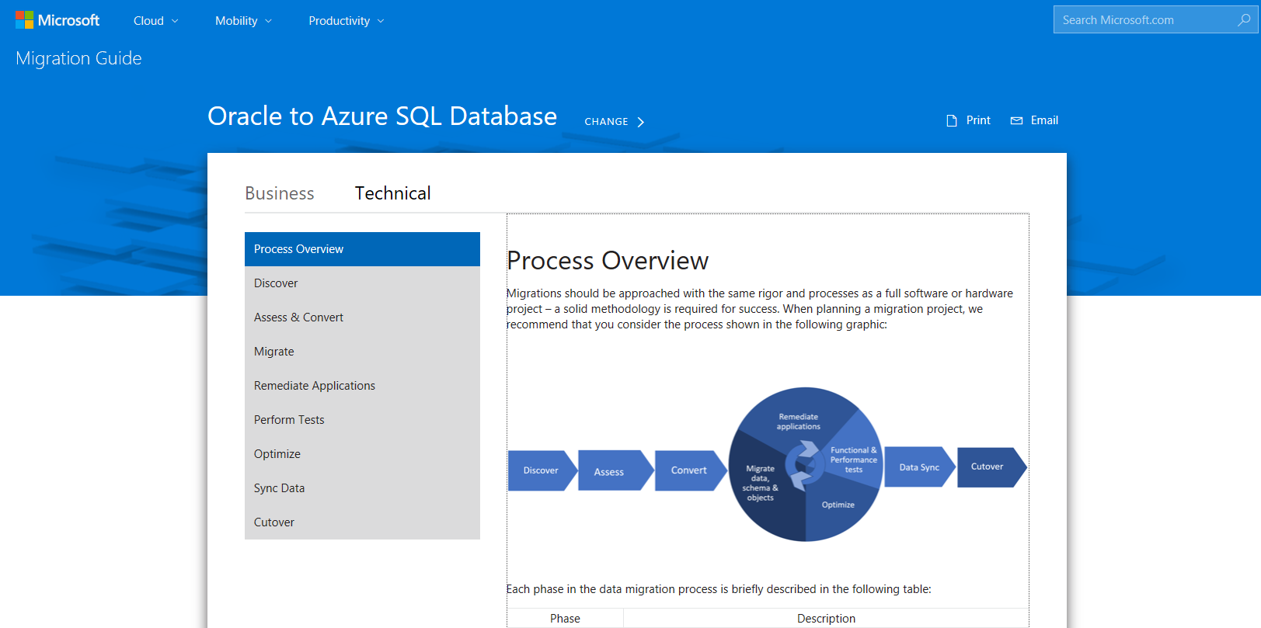
Database Migration Guide
One-stop-shop guide for database migrations
Step-by-step guidance from by source and target
Recommended Partners, Customer case studies
View the Migration Guide at: http://datamigration.microsoft.com/

Slide 15
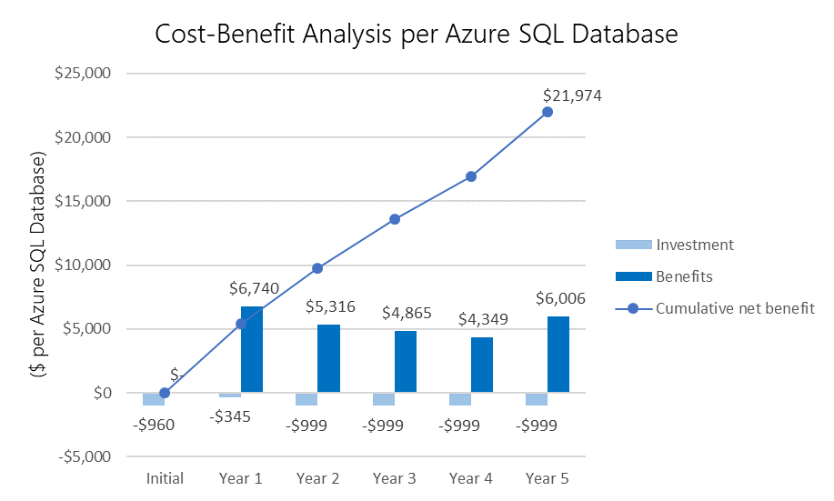
Competitive total cost of ownership
Up to 406% ROI with Azure SQL Database
Reduce capital and operational costs with fully-managed service and achieve up to 406% ROI¹
Financially-backed 99.99% availability SLA²
Promote business continuity with built-in capabilities
Maximize your on-premises investments with Azure Hybrid Benefit for SQL Server
Right-size on-premises workload requirements for the cloud with independent control of storage and compute
Adapted from The Business Value of Microsoft Azure SQL Database Services, IDC, March 2015.
Notes:
You can achieve up to 406% ROI or more versus on-premises and hosted alternatives with SQL Database. Lower operational costs and redirect resources to more value-add projects using a fully-managed solution that requires near-zero administration for patching or upgrading. Per IDC, organizations can achieve up to 406% ROI on Azure SQL Database by minimizing IT administrative costs, reducing capital and operational costs associated with maintaining on-premises or hosted databases and improving scalability, among others, resulting in a cumulative net benefit of nearly $22,000 per database over a 5-year period.
Protects your data and maintains business continuity with built-in high availability and business continuity tools. Azure's financially-backed 99.99% availability SLA², powered by a global network of Microsoft-managed datacenters over 40 regions, helps keep your apps running 24/7. In addition, SQL Database provides built-in business continuity and global scalability features such as automatic backups, point in time restores and active geo-replication to minimize data loss and achieve fast recovery after disruptive events.
Minimize data loss from disruptive events achieve recovery with recovery point objective (RPO) of less than 5 seconds. (AWS provides an RPO commitment of 5 minutes)
Protect against data center outages with up to four readable secondary databases enabled through active geo-replication.
Automatically create full, differential, and transaction log backups every 5 - 10 minutes.
Restore an existing database to an earlier point in time up to 35 days on the same logical server.
Maximize the value from current on-premises licensing investments and accelerate their modernization to the cloud with Azure Hybrid Benefit for SQL Server. Azure Hybrid Benefit for SQL Server helps you get more value from your SQL Server licenses with Software Assurance by providing discounted rates on SQL Database Managed Instance.
Align your on-premises workload requirements with compute and storage resources in the cloud using familiar core-based comparisons.
¹ The Business Value of Microsoft Azure SQL Database Services, IDC, March 2015.
² We guarantee at least 99.99% of the time customers will have connectivity between their single or elastic Basic, Standard, or Premium Microsoft Azure SQL Database and our Internet gateway. See “SLA for SQL Database” for more information (https://azure.microsoft.com/en-us/support/legal/sla/sql-database/v1_1/)

Slide 16


dtus simplify certain elements for customers but can make on-premises transitions difficult
Challenges with translating on-premises workload requirements to the cloud when migrating
More flexibility desired to optimize resources for SQL Database workloads
Notes:
The Database Transaction Unit (DTU) is the unit of measure in SQL Database that represents the relative power of databases based in a real-world measure: the database transaction. Microsoft took a set of operations that are typical for an online transaction processing (OLTP) request, and then measured how many transactions could be completed per second under fully loaded conditions.
While DTUs simplify many elements for customers looking for an off-the-shelf, preconfigured solution, customers transitioning to the cloud need more flexibility and choice – more options.
When migrating to the cloud, customers must inventory their on-premises workloads to determine the right amount of resources to purchase in the cloud based upon on-premises needs. They need a straightforward way to map compute, storage and the like to SQL Database resources.
Once in the cloud, customers want the flexibility to optimize performance for a particular workload, which requires independent control of compute and storage resources to meet their needs.

Slide 17

Right-size your workloads for the cloud
Introducing vCores
Easier to right-size the destination environment by removing the guesswork of DTUs
You pay only for what you use
1 on-premises core = 1 vCore on Gen4 hardware
Notes:
We’d like to introduce the vCore, the basis of the new purchasing model.
A virtual core (vCore) is a representation of compute power in the cloud. A virtual core represents the logical CPU available for your server offered with an option to choose between generations of hardware.
Managed Instance, for example, is tailored for on-premises workloads that are looking to move to the cloud. Customers with these workloads are accustomed to sizing these using physical cores on-premises. Thus, a vCore is a simpler way for customers to understand their compute requirements in the cloud vs. what they use on-premises today, allowing them to right-size their destination environment in the cloud and pay only for what they use.
NOTE: For servers created using Gen4 vCores, they are based on Intel E5-2673 v3 (Haswell) 2.4 GHz processors. For servers created using Gen5 vCores, they are based on Intel E5-2673 v3 (Haswell) 2.4 GHz processors.

Slide 18
Committed to customer choice
Choose from two tiers in the vCore-based model
 | GENERAL PURPOSE |  |  | BUSINESS CRITICAL
Best for | Most business workloads. Offers budget oriented balanced and scalable compute and storage options. |  |  | Business applications with high IO requirements. Offers highest resilience to failures using several isolated AlwaysON replicas.
Compute tiers | Two hardware generations to choose from
 | Single/Elastic Pools | Managed Instance | Managed Instance | Single/Elastic Pools | Managed Instance
 | 1 to 72 vCores | 8, 16, 24, 32, 40 vCores | 8, 16, 24, 32, 40 vCores | 1 to 72 vCores | 8, 16, 24, 32, 40 vCores
Storage | Premium remote storage (per instance) |  |  | Super-fast local SSD storage (per instance)
 | Single/Elastic Pools |  | Managed Instance | Single/Elastic Pools | Managed Instance
 | 5GB – 4TB |  | 32GB – 8TB | 5GB – 4TB | 32GB – 4TB
Availability | 1 replica, no read-scale |  |  | 3 replicas, 1 read-scale**, zone-redundant HA***
Backups | RA-GRS, 7-35 days (7 days by default) |  |  | RA-GRS, 7-35 days (7 days by default)
Choice drives our approach to resource management and pricing
Simplicity: We remain committed to the DTU-based model and the simplicity it offers customers who want a pre-configured solution
Flexibility: The vCore-based model reflects our commitment to customer choice and to simplify the hybrid benefit for customers migrating from on-premises
Customers pay for:
Service tier + number of vCore
Type and amount of data storage
Number of IO*
Backup storage (RA-GRS)*
The vCore-based model will exist alongside the DTU-based model
Learn more
* Free during preview
** Not supported in Managed Instance preview
***Coming soon
Notes:
We’re committed to customer choice and as such, the DTU-based model and vCore-based models will both be available to SQL databases and elastic pools, offering simplicity and flexibility when it comes to resource management and pricing. The DTU-based model will not be available in the Managed Instance option.
The vCore-based model includes two options, differentiated by the level of HA and storage performance required by the customer’s workload. These two options are General Purpose and Business Critical.
General Purpose is great for most business workloads. It offers budget-oriented, balanced and scalable compute and storage options.
Business Critical is great for business applications that have high IO requirements. It offers the highest resilience to failures using 3 isolated AlwaysON replicas with one read-scale.
Within these options, pricing will be based upon the number of vCores and storage and whether the license is included or if the customer is using the Azure Hybrid Benefit for SQL Server to maximize their on-premises license investment.
* Public Preview of Managed Instance will initially include General Purpose service tier only. During the first few months of Public Preview, Business Critical service will stay in private preview without full support for production workloads. Microsoft will provide full production support for Business Critical service tier in July 2018.

Slide 19
Azure is the most economical destination for SQL Workloads*
Save up to 55% with Azure Hybrid Benefit for SQL Server (Managed Instance pricing)
Total monthly cost of 8 vCore Managed Instance Business Critical option
Up to 55% savings¹
What is Hybrid Benefit for SQL Server?
An Azure benefit that allows you to use your on-premises SQL Server licenses to save on SQL Database Managed Instance. You can save up to 30% on Managed Instance
How do you qualify?
You must have on-premises SQL Server licenses with active Software Assurance
How do you activate this benefit?
Deploy a SQL DB Managed Instance and select Azure Hybrid Benefit as an option in the portal.
Learn more
Customer total cost
License included
With Azure Hybrid Benefit
 | General Purpose (GA) |  | Business Critical (GA)
Pricing (monthly) | License Included | AHB for SQL Server | License Included | AHB for SQL Server
8 vCores | $1,501 | $906 | $4,044 | $1,812
16 vCores | $3,002 | $1,812 | $8,087 | $3,623
24 vCores | $4,503 | $2,717 | $12,130 | $5,435
Type of Storage/IO | Included with Compute (per SKU) | Additional price
General Purpose | 32 GB | $0.125/GB-Month
Business critical | 32 GB | $0.250/GB-Month
IO rate | NA | $0.20 per 1 million requests
¹ Savings based on eight vCore Managed Instance Business Critical in East US Region, running 730 hours per month. Savings are calculated from full price (license included) against base rate (applying Azure Hybrid Benefit for SQL Server), which excludes Software Assurance cost for SQL Server Enterprise edition, which may vary based on EA agreement. Actual savings may vary based on region, instance size and performance tier. Prices as of December 2017, subject to change.
*Based upon comparison of on-demand pricing on Azure for Managed Instance versus running SQL on AWS RDS.
Notes:
The Azure Hybrid Benefit for SQL Server helps you maximize the value from your current licensing investments and accelerate your migration to the cloud. Azure Hybrid Use Benefit for SQL Server is an Azure-based benefit that enables you to use your SQL Server licenses with Software Assurance to pay a reduced rate (“base rate”) on vCore-based SQL Database deployment options.

Slide 20
Choose from two hardware generations
 | Gen 4 | Gen 5
Hardware | Intel E5-2673 v3 (Haswell) 2.4 GHz processors vCore = 1 PP (physical core) | Intel E5-2673 v4 (Broadwell) 2.3 GHz processors, fast eNVM SSD vCore=1 LP (hyper-thread)
Performance levels | 1, 2, 4, 8, 16, 22 vCores | 2, 4, 8, 16, 24, 32, 48, 72 vCores
Memory | 7GB per vCore | 5.5GB per vCore
Storage | Up to 4TB premium remote storage Up to 1TB local SSD storage | Up to 4TB premium remote storage Up to 4TB local SSD storage
Balance performance requirements and price with two hardware generations
Match your on-premise application behavior
Notes:
Here’s a double-click on the performance summary we just spoke about on the previous slide. Customers will be able to further balance price and performance requirements with the ability to choose between two hardware generations, Gen 4 and Gen 5.
Our goal is to enable maximum flexibility so customers can choose a performance configuration that most closely matches the needs of their application. In particular, Gen 4 hardware offers more memory per vCore. However, Gen 5 hardware allows you to scale up compute much higher. We want to make these differences transparent so customers can achieve the optimal price/performance ratio for their application.

Slide 21
Selecting the right purchasing option
Flexibility
vCore-based
Independently configure compute, storage, IO
Most economical with Azure Hybrid Benefit for SQL Server
Simplicity
DTU-based
Blended measure of compute, storage, IO
May be more economical for < 3 cores
Compare vCore-based and DTU-based options using this rule of thumb: 100DTU ~ 1 vCore
Convert from DTU to vCore using the API or portal with no downtime and same SLO update as today
Notes:
So, how do customers select the right option for them? To start, both models provide the benefits of a fully-managed service such as automated backups, software updates and patches. After that, it comes down to customer preference and their workload requirements.
For customers who need more insight into the underlying resources or need to scale them independently to optimize performance, the vCore-based model will be the best choice. Additionally, if a customer has an active Software Assurance (SA) for SQL Server, they can use their existing investment and save up to 30% with Azure Hybrid Benefit for SQL Server.
However, for customers who do not want to worry about the underlying resources and prefer the simplicity of a preconfigured bundle and pay a fixed amount each month, the DTU-based model may be more suitable for their needs.
[The Database Throughput Unit (DTU) is based on a blended measure of CPU, memory, reads, and writes. The DTU-based performance levels represent preconfigured bundles of resources to drive different levels of application performance.]
Existing customers may be interested in moving their DTU-based workloads to vCore-based and may have questions about how to compare them, “apples to apples.”
The new vCore-based service tiers offer comparable performance choices for all elastic pools and databases using 100 DTUs or more.
For existing SQL Database applications using the DTU-based model, the General Purpose service tier is comparable to the Standard tier. The Business Critical service tier is comparable to the Premium tier. In both cases, customers should allocate at least 1 vCore for each 100 DTU that their application uses in the DTU-based model. We will continue to add more SLOs over time to accommodate for sub-100 DTU workloads.
The new vCore-based service tiers offer a simple online conversion method that is similar to the existing process of upgrading databases from Standard to Premium service tier and vice versa. This conversion can be initiated using Portal, ARM, PowerShell, Azure CLI or T-SQL.

Slide 22
Exclusive to Azure: Get more for your virtualized workloads
SQL Server license trade-in values
SQL Database Managed Instance
Take an inventory of on-premises licenses to determine potential for conversion
Convert on-premises cores to vCores to maximize value of investments
1 Standard license core = 1 General Purpose core
1 Enterprise license core = 1 Business Critical core
1 Enterprise license core = 4 General Purpose cores (virtualization benefit)
General Purpose
Business Critical
General Purpose
OR
Highly virtualized, Enterprise Edition
Enterprise Edition
Standard Edition
SQL Server with Software Assurance
Notes:
There is an additional benefit in the Azure Hybrid Benefit for SQL Server that is exclusive to Azure and a unique benefit over license mobility. SQL Server Enterprise Edition customers can use an unlimited virtualization benefit for their on-premises workloads. However, moving to the cloud to take advantage of its management, flexibility and cost benefits can be cost prohibitive for some heavily virtualized customers. The hybrid benefit provides SQL Server Enterprise Edition customers with Software Assurance the ability to get 4 cores in the cloud for every 1 core they own on-premises for workloads moving to the General Purpose SKU. This makes moving virtualized applications to SQL Database highly cost effective as customers will not have to purchase incremental vCores to move their virtualized application to the cloud.
---------------------------
Virtualization creates a simulated, or virtual, computing environment as opposed to a physical environment. Virtualization often includes computer-generated versions of hardware, operating systems, storage devices, and more. This allows organizations to partition a single physical computer or server into several virtual machines. Each virtual machine can then interact independently and run different operating systems or applications while sharing the resources of a single host machine.

Slide 23


“We were able to migrate an app with zero friction to a Managed Instance, with features like CLR and SQL Agent just working. Database Migration Service will be crucial for pulling off migrations like this at scale.”
Sankar G. Prayaga
Lead Engineer, EY

Slide 24


“SQL Managed Instance is that happy medium we were looking for. We needed the power and compatibility of SQL Server, but without the management overhead and cost that comes with running VMs 24x7. Not only will we get that power and ease of management, we’ll also be able to use the Azure Hybrid Use benefit, which allows us to use our existing SQL Server licensing through Software Assurance. Developing, deploying and managing our application is getting a whole lot easier and cheaper with Azure and SQL Managed Instance.”
Robert Shurbet
Pivot Technology Solutions

Slide 25

“We deploy our SQL Server schema elements into a Managed Instance and we point the application via connection string change directly over to the Managed Instance.”
Eric Fleischman
Vice-President and Chief Architect

Slide 26
Azure sql database managed instance preview
Enroll today in Managed Instance preview
Submit a provisioning request for Managed Instance via Azure portal, accept the preview terms and complete the short form.
You will receive a response from Microsoft within 3 working days
Once approved, return to the portal to complete the provisioning request
Managed Instance created within 3-5 working days upon completing the provisioning request
Start provisioning request in
Azure Portal and accept the preview terms
https://aka.ms/sqldbclassessment
Complete survey (optional)
SQL
SQL
Notification (3 business days)
Complete provisioning request in portal
Managed Instance created
(3-5 days)
Notes:
Throughout the initial stages of the public preview rollout we want to ensure the best experience for our customers as we ramp up capacity. Depending upon demand, we may occasionally bump against capacity constraints, which we control for with an enrollment-driven public preview approach. You can enroll in public preview via the Azure portal. If your enrollment is initially denied, we invite you to re-enroll in the portal after 2-4 weeks’ time.

Slide 27
Learn more
Announcement blog
Azure SQL Database
SQL Database Managed Instance
Azure Hybrid Benefit for SQL Server
Azure Database Migration Service
Migration Guide
SQL Server Integration Services
Hands-on-lab to lift SSIS to Azure with Azure Data Factory: aka.ms/adflab 2

Slide 28
Reach out to your Microsoft seller or partner to schedule a Modern Data Estate assessment
Enroll in Managed Instance preview today

Slide 29
Get the best of data in the cloud with Azure SQL Database
Increased productivity
Faster time to market
47% staff time reclaimed for other tasks
75% faster app deployment cycles than competing databases
Lower TCO
Reduced risks
53% less expensive than on-prem/hosted
71% fewer cases of unplanned downtime than competing databases
*Data source: The Business Value of Microsoft Azure SQL Database Services, IDC, March 2015
Notes:
Azure SQL Database, a fully-managed relational database service, delivers predictable performance at multiple service levels that provide dynamic scalability with minimal or no downtime, built-in intelligent optimization, global scalability and availability, and advanced security options — all with near-zero administration. These capabilities allow you to focus on rapid app development and accelerating your time to market, rather than allocating precious time and resources to managing virtual machines and infrastructure.

Slide 30
Appendix

Slide 31
Applying Azure hybrid benefit
How to calculate instances eligible for the hybrid benefit
Example:
Customer A has:
10 Standard Edition license cores
10 Enterprise Edition license cores
Wants a:
8 vCores Managed Instance
Calculation = (10 Standard license cores * 1 core) + (10 Enterprise license cores * 4 cores) = 50 cores
Eligible number of instances:
(50 cores / 8 vCore instance) = 6 eligible instances
Example:
Customer B has:
5 Standard Edition license cores
20 Enterprise Edition license cores
Wants a:
16 vCores Managed Instance
Calculation = (5 Standard license cores * 1 core) + (20 Enterprise license cores * 4 cores) = 85 cores
Eligible number of instances:
(85 cores / 16 vCore instance) = 5 eligible instances
Managed Instance is available in 8, 16, 24, 32 and 40 vCore instances
The number of instances eligible for Azure Hybrid Benefit is calculated based upon
number and type of licenses you are exchanging
Managed Instance vCore selection, rounding down to the nearest whole value.
1 Standard license core = 1 General Purpose core
1 Enterprise license core = 4 General Purpose cores (virtualization benefit)

Slide 32
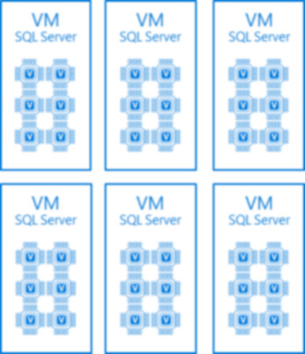

What is virtualization?
Virtual vs physical computing environment
A single server partitioned into multiple, independent virtual machines that share the resources of the host server
Benefits: less infrastructure costs and maintenance
License all physical cores in the server
Deploy VMs equal to number of core licenses
VM
SQL Server
VM
SQL Server
VM
SQL Server
VM
SQL Server
VM
SQL Server
VM
SQL Server
Physical cores | 6 | 6 | 12
Core licenses | 6 | 6 | 12
*Shown is an example of licensing a 12-core physical server for unlimited VMs with EE core licenses and SA
Notes:
Virtualization creates a simulated, or virtual, computing environment as opposed to a physical environment. Virtualization often includes computer-generated versions of hardware, operating systems, storage devices, and more. This allows organizations to partition a single physical computer or server into several virtual machines. Each virtual machine can then interact independently and run different operating systems or applications while sharing the resources of a single host machine.
By creating multiple resources from a single computer or server, virtualization improves scalability and workloads while resulting in the use of fewer overall servers, less energy consumption, and less infrastructure costs and maintenance. There are four main categories virtualization falls into. The first is desktop virtualization, which allows one centralized server to deliver and manage individualized desktops. The second is network virtualization, designed to split network bandwidth into independent channels to then be assigned to specific servers or devices. The third category is software virtualization, which separates applications from the hardware and operating system. And the fourth is storage virtualization, which combines multiple network storage resources into a single storage device where multiple users may access it.
https://azure.microsoft.com/en-us/overview/what-is-virtualization/
For organizations with a large number of VMs and complex, highly dynamic virtual environments, Microsoft offers the option to license for maximum virtualization. This means that when all of the cores on a server are licensed and covered with Software Assurance, a customer can deploy any number of VMs on the server.
The key benefits of licensing for maximum virtualization are simplicity and potential cost savings. Maximum virtualization ensures that customers are covered, without needing to be concerned with tracking individual VMs or the amount of power assigned to each VM. This is especially relevant for private cloud scenarios with a large number of VMs being moved dynamically between different physical servers, when self-provisioning is enabled, or when hyper-threading is turned on.
With SQL Server 2017 Enterprise Edition, customers who have licensed all physical cores on the server can run an unlimited number of instances of the software in a number of OSEs (physical and/or virtual) equal to the number of core licenses assigned to the server. For example, a four-processor server with four cores per processor—fully licensed with sixteen core licenses—can run SQL Server software in up to sixteen VMs, regardless of the number of virtual cores allocated to each VM.
• Customers who have licensed all the physical cores on the server and want to run SQL Server 2017 software in more VMs than are permitted, can assign additional core licenses to the licensed server.
• Each additional core license allows deployment of SQL Server software in an additional VM, so in the previous example, a customer who wants to run SQL Server Enterprise Edition in eighteen VMs would simply acquire and assign eighteen core licenses to that server.
With the addition of Software Assurance (SA) coverage on all Enterprise Edition core licenses (for a fully licensed server), customers’ use rights are expanded to allow any number of instances of the software to run in any number of OSEs (physical or virtual). This valuable SA benefit enables customers to deploy an unlimited number of VMs to handle dynamic workloads and fully utilize hardware computing capacity.

Slide 33
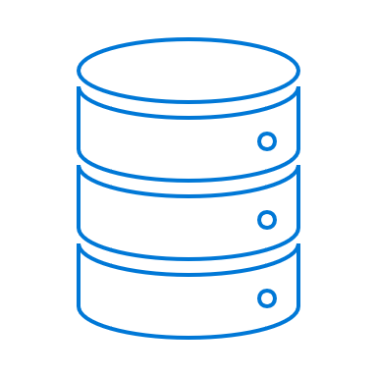
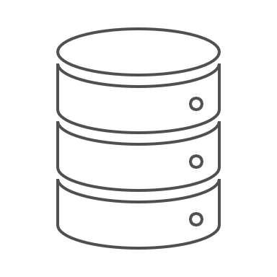
High-Virtualization benefit for AHB for SQL Server
For virtualized EE workloads, customers get 4X vCore on Azure SQL DB vs. 1X core on Azure IaaS
SQL Database Managed Instance
Cost on SQL DB (MI)= $6.21
@1:4 Trade-in
AHB for SQL Server with Managed Instance
8 vCore at Base rate w/ SA
8 vCore at Base rate w/ SA
8 vCore at Base rate w/ SA
8 vCore at Base rate w/ SA
$1.55
$1.55
$1.55
$1.55
Enterprise Edition Customer
Highly Virtualized
e.g. 32 core virtualized workload with 8 core SQL EE License
SQL DB will be ~22% cheaper than Azure IaaS
Cost on Azure IaaS= $7.92
Hosted/VM
@1:1 Trade-in
License Mobility for Azure IaaS Standard SE
8 core at BYOL w/ SA
8 core at License Included
8 core at License Included
8 core at License Included
$2.39
$1.85
$1.85
$1.85
Customer must purchase License Included Cores to get equivalent value on Azure IaaS
*All the SKUs above are 8 vCPU or vCore memory optimized equivalent. (D13v2 for Azure IaaS). The SA cost are based Open NL EE for SA. The License included prices are 8 core D13v2 for Azure IaaS. US East price. ** Prices as on Oct 2 2017

